Slide 1
Promovendi in the Faculty of Humanities
Our PhDs and PhD policy & the Dissertation Path
Anne van Dam & Kirsten Kapeijns, AIHR
10-02-2026

Slide 2



Background

Slide 3
Different PhD categories
UNL Type | No. (1-10-2025) | Example
1a PhD Candidate with Employee Status | 142 | PhD withing a NWO or ERC-project
1b Employee in PhD Track | 5 | Employee in another primary role who also does a PhD and receives some renumeration for this
2 PhD Candidate with a Scholarship | 15 | PhDs with funding from the CSC, LPDP, or another funder
3 Externally Funded PhD Candidate | 71 | Employee working at an external party (f.e. NIOD, Gemeente Amsterdam) who is renumerated by this external partner for their tasks
4 External Funded PhD Candidate | 264 | PhD who supports their own project

Slide 4
 | Funded | Self-funded
Salary | V | X
Right to a (flex) desk and laptop | V | X
UvA-Net ID | V | V
Printing, coffee, tea | V | V
Research budget | V (through research project) | V (through UvA, +/- 4.500 euros)
Access to PhD Skills | V | V
Pilot meeting | V | V
Access to research school activities | V | V
Required to teach | V | X
Required to log leave and report illness | V | X

Slide 5
Our PhD Community
Significant growth between 2018 and 2025 of especially self-funded PhDs
Quite a big discreptancy between the number of funded and self funded PhDs (+/- 25% versus 75% over all)
Large differences between research schools in how the PhD community is made up

Slide 6
Some of our worries
Delays are visible across all categories of PhDs
PhDs generally take 6 years to come to a defendable manuscript, often more
Ex-funded PhDs struggle or even stop if they don’t finish their PhDs within 6 years, due to other commitments
Self funded PhDs are more likely to quit their PhD

Slide 7

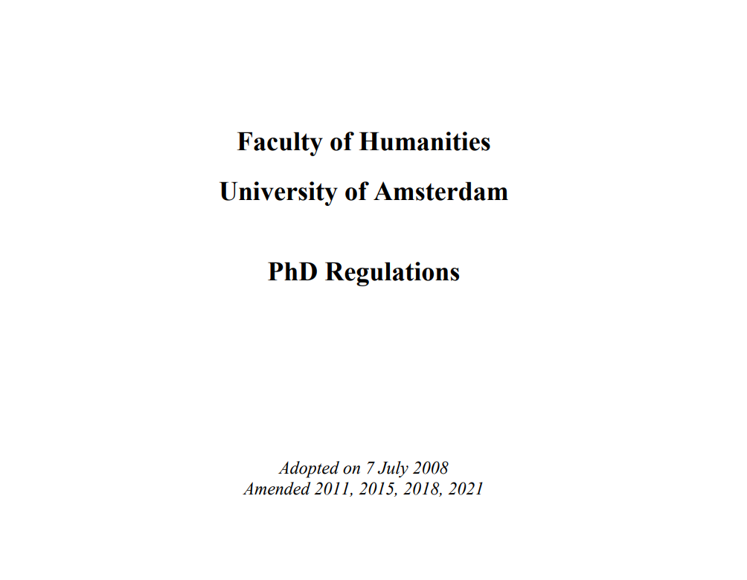
New PhD policy

Slide 8
Focus of our new PhD policy
Better balance between funded and self-funded PhDs
Clearer admission procedures (leading to stronger proposals)
Aiming for a higher completion rate within 6 years
Improving the use of structural already in place to support PhD wellbeing
Improving information flow for PhDs and supervisors
Hora Finita (PhD administration system) will help PhDs stay in control of their trajectories

Slide 9

Dissertation path: practical matters

Slide 10
PhD Trajectory
Admission form PhD trajectory
    Needs to be submitted as soon as possible, definitely within one year
Change of supervisory team composition:
    To register correctly a new admission form is necessary
    e.g. member leaving, member added, copromotor to promotor or vice versa
    Don’t wait until the end of the trajectory when the title page is made

Slide 11
Timeline dissertation
± 6 months
before
14 weeks
before
6 weeks
after sending
4 weeks
before
DEFENCE
Committee
proposal
Thesis to
Committee
Deadline
Committee
Final version
dissertation
Promotion Regulations 2020
5-7 members
50% UvA members
Majority (<50%) members with ius promovendi
At least one member is a full professor at the Faculty of Humanities
At least one member is a full professor at a different institution
Co-authors cannot form the majority of the committee
Faculty Regulations
At least one female member
Promotor sends list to FCP (faculty contact person)
Date can be reserved after approval
Before sending to committee, let FCP check the manuscript
Simultaneously plagiarism check is performed
Share list of changes with FCP after approval promotor

